Slide 1
Review Lecture 1
Course Introduction
Network and Internet
Classification of Networks
Networks in Daily Life
Complexity in Computer Networking
Mastering the Complexity

Slide 2
COMPUTER NETWORKS
Lecture-2
Dr.M. Sheraz Arshad Malik

Slide 3
CHAPTER No. 2
MOTIVATION and TOOLS

Slide 4
Resource Sharing
Sharing a peripheral device such as a printer or a disk
Sharing a large-scale computational power, because
  Computers were extremely expensive
  The government budgets were not sufficient to provide computers for all scientists and engineers

Slide 5
Growth of the Internet
U.S Department of Defence Advanced Research Projects Agency (ARPA) started ARPANET project
The early internet emerged in 1970s
Has grown drastically since then

Slide 6
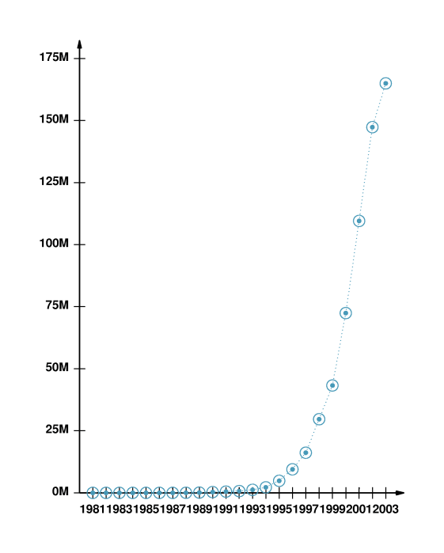
Growth of the Internet

Slide 7
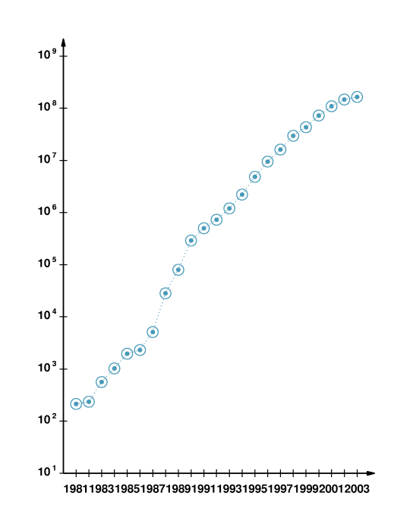
Growth of the Internet

Slide 8
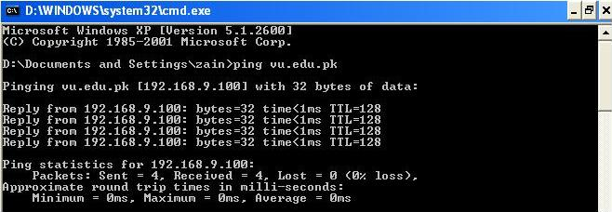
Probing The Internet
“PING” program

Slide 9
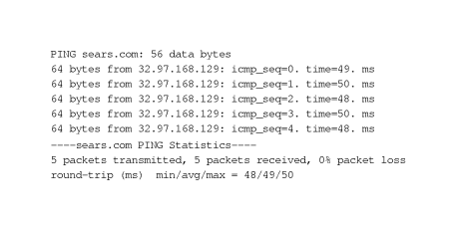
Probing The Internet
“PING” program

Slide 10
Probing The Internet
Problems with the ping
  “Ping” cannot tell the reason of the problem
  Some networks or computers reject the ping packets
  “Traceroute”

Slide 11
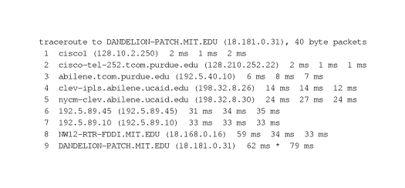
Probing The Internet
Tracing A Route

Slide 12
Summary
Resource Sharing
Growth of the Internet
  Linear Scale
  Log Scale
Tools for Probing the Internet
  PING
  TRACE ROUTE

